Slide 1



Comprehensive machine learning pipeline integrating automation, data processing, model training, and monitoring.
Tan Jun Han blandon

Slide 2
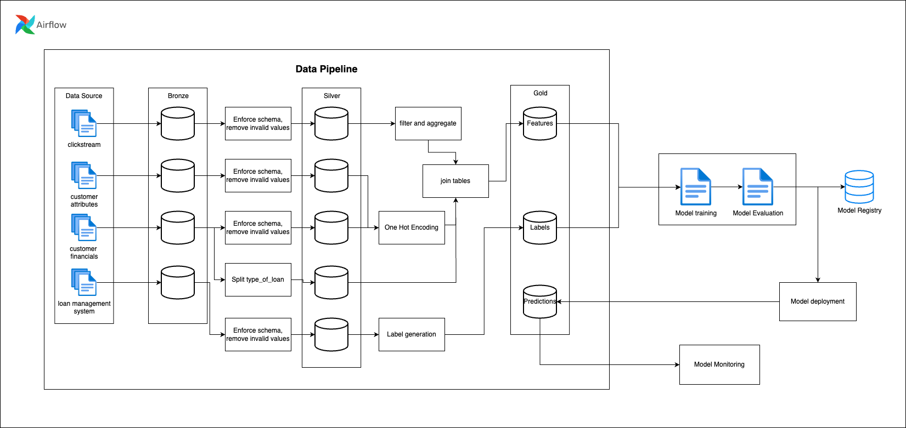
Machine Learning Architecture Overview

Slide 3
Automated machine learning pipeline from raw data to predictions.
High-Level Flow
Raw Data → Bronze Tables → Silver Tables → Gold Tables → Model Training → Predictions → Monitoring
Key Components
Data Processing: 3-stage medallion architecture
Model Training: XGBoost with hyperparameter tuning
Prediction Engine: Real-time scoring with optimal thresholds
Monitoring System: Performance tracking and drift detection
Orchestration: Airflow DAG with 8 interconnected tasks

Slide 4
Data Processing Architecture
Bronze Layer
Silver Layer
Gold Layer
Purpose: Store raw data in partitioned format
Sources: 4 data streams
Clickstream data (feature_clickstream.csv)
Customer attributes (features_attributes.csv)
Financial data (features_financials.csv)
LMS loan data (lms_loan_daily.csv)
Partitioning: Monthly partitions (first of each month)
Format: Parquet with Spark processing
Purpose: Cleaned, validated, and enriched data
Processing: Schema validation, data quality checks
Output: Structured tables ready for feature engineering
Purpose: Analytics-ready datasets
Outputs:
Feature store: All engineered features for ML
Label store: Target variables and metadata
Usage: Direct input for model training

Slide 5
Model Training PiPeline
Training Framework: XGBoost 3.0.2
Data Splitting Strategy:
Training: 60% of data
Validation: 20% of data
Test: 20% of data
Out-of-Time (OOT): 3-month window
Feature Engineering:
StandardScaler normalization
ID column removal (customer_id, snapshot_date)
Automated feature importance ranking
Model Optimization:
Baseline XGBoost with default parameters
GridSearchCV for hyperparameter tuning
Threshold optimization for F1 score
Cross-validation with predefined splits
Hyperparameter Tuning Grid
n_estimators: [100, 200, 300]
max_depth: [4, 6, 8]
learning_rate: [0.05, 0.1, 0.15]
subsample: [0.8, 0.9]
colsample_bytree: [0.8, 0.9]
reg_alpha: [0, 0.1, 1]
reg_lambda: [1, 2, 5]
min_child_weight: [1, 3, 5]

Slide 6
Model Evaluation & Metrics
Primary Metrics
F1 Score: Harmonic mean of precision and recall
F1.5 Score: Weighted F-score favouring recall
AUC-ROC: Area under the receiver operating curve
Precision/Recall: Individual classification metrics
Validation Strategy
Training Performance: Cross-validated grid search
Test Performance: Hold-out test set evaluation
Temporal Validation: Out-of-time dataset performance
Threshold Optimization: F1-maximizing threshold selection
Model Persistence
Model artifacts saved to /opt/airflow/models/
Includes: trained model, scaler, optimal threshold, metadata
Format: Joblib serialization for Python compatibility

Slide 7
Prediction & Scoring Engine
Real-time Prediction Workflow
Data Loading: Read features from gold layer
Preprocessing: Apply fitted scaler transformation
Scoring: Generate probabilities using trained model
Classification: Apply optimal threshold for binary predictions
Output: Structured predictions with metadata
Prediction Output Format
customer_id: [...]
prediction_binary: [...]
prediction_proba: [...]
threshold_used: 0.x
model_run_id: run_id
prediction_timestamp: YYYY-MM-DD HH:MM:SS

Slide 8
Monitoring & Model Governance
Performance Monitoring
Real-time Metrics: F1, AUC, precision, recall
Distribution Analysis: Prediction probability percentiles
Confusion Matrix: Detailed classification breakdown
Data Quality Checks
Missing Values: Column-wise null value detection
Extreme Values: Very low/high probability detection
Consistency: Prediction count and rate validation
Drift Detection
Performance Drift: AUC difference from training
Alert Thresholds: >5% AUC degradation triggers alerts
Historical Tracking: Model performance over time
Monitoring Output
total_predictions: 10000
positive_rate: 0.15
current_f1: 0.85
current_auc: 0.92
drift_alerts: ["HIGH AUC DRIFT: 0.07"]
data_quality_issues: false

Slide 9
Future Enhancements & Roadmap
Short-term Improvements
Feature Store Integration: Centralized feature management
A/B Testing Framework: Model comparison and champion/challenger
Real-time Inference: Streaming prediction capabilities
Advanced Monitoring: Statistical drift detection algorithms
Medium-term Enhancements
AutoML Integration: Automated model selection and tuning
Explainability: SHAP values and model interpretability
Multi-model Support: Ensemble methods and deep learning
Cloud Integration: AWS/GCP deployment and scaling
Long-term Vision
MLOps Maturity: Complete CI/CD for model deployment
Edge Deployment: On-device inference capabilities
Federated Learning: Distributed model training across data sources
Regulatory Compliance: Enhanced model governance and documentation

Slide 10
Conclusion
The following machine learning pipeline represents a
Robust Data Engineering: Medallion architecture with Spark processing
Advanced ML Training: XGBoost with comprehensive hyperparameter tuning
Operational Excellence: Monitoring, drift detection, and model governance
Scalable Infrastructure: Airflow orchestration with optimized resource management
Key Strengths:
Complete automation from raw data to business insights
Production-ready error handling and monitoring
Scalable architecture supporting large datasets
Comprehensive model evaluation and validation
Ideal For: Credit risk assessment, customer scoring, and similar binary classification problems requiring high reliability and interpretability.

